Slide 1
WELCOME

Slide 2

DEPARTMENT OF COMPUTER SCIENCE & ENGINEERING
SUBJECT:DATABASE MANAGEMENT SYSTEM
CODE:UE17CS252
PROJECT REPORT
ON
“DAIRY MANAGEMENT SYSTEM”
SUBMITTED BY:
MANASA:PES1201701886
PRIYANKA:PES1201802433
D SHILPA:PES1201802362
GUIDED BY:
Dr. MAMATHA .H.R

Slide 3
LIST OF TABLES AND THEIR ATTRIBUTES
SNO. | TABLE NAMES | NO.OF ATTRIBUTE | NO. OF TUPLES
1. | DAIRY | 05 | 12
2. | EMPLOYEE | 13 | 69
3. | DAIRY_LOCATION | 04 | 20
4. | MILKMAN | 07 | 45
5. | MILK | 05 | 55
6. | DEPENDENT | 06 | 51
7. | MILKPRODUCTS | 04 | 84
8. | CUSTOMER | 04 | 100
9. | BILL | 04 | 147

Slide 4
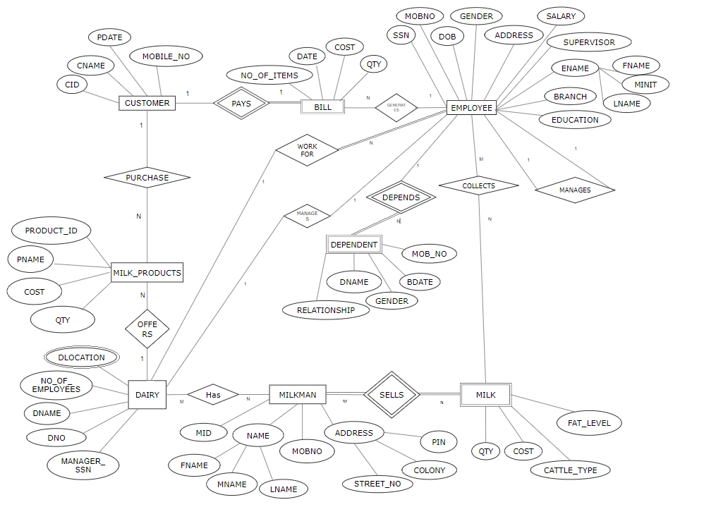
ER DIAGRAM

Slide 5
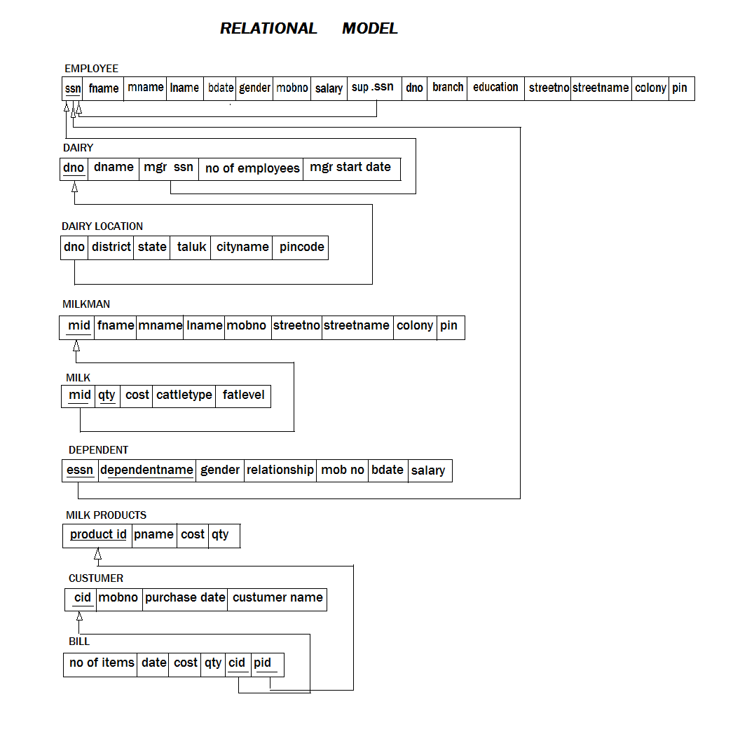

Slide 6
CASE STUDY
Existing System
When we Analysis the Manage about this firm then we face that they working with manual. And we all know that the manual system has many disadvantages. Some are mentioned below…
The manual system requires more time for processing.
It requires more critical work.
The manual system is more error prone.
Difficult to maintain.
Manual system is costly.
Immediate response to the queries is difficult and time consuming.
More men power needed.
Menual system show of the particular place.

Slide 7
Need for New System
New system is required because of some advantage of new system are as below…
The new system required less time for completion of any work.
New system is decreasing the chances of error.
New system should work smoothly and very fast.
New system saving time and manpower.
The system is user friendly and any one having computer knowledge can handle it easily.
Suitability for computerized data entry. Maintaining Dairy information, Staff information & Customer information, Milk Rate Information.

Slide 8
Thank you

